Slide 1
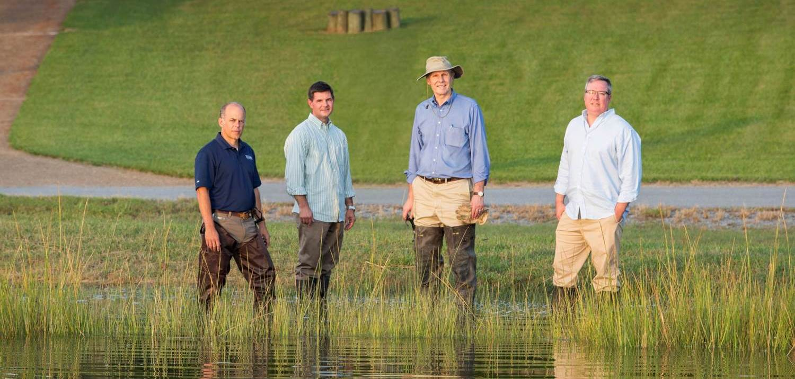
Wetlands Law and Regulation in Virginia
January 21, 2022
.

Slide 2
What We Will Cover Today
How to Identify Wetlands
Why Wetlands Matter
How Wetlands Came to be Regulated
Federal Regulation vs. Regulation by Virginia
Activities in Wetlands that Do and Do Not Require Permits
Permit Process
Enforcement
Questions

Slide 3
How to Identify Wetlands
USACE 1987 Delineation Manual
“Wetland: those areas that are inundated or saturated by surface or groundwater at a frequency and duration sufficient to support, that under normal circumstances do support, a prevalence of vegetation typically adapted for life in saturated soil conditions”
Regional Supplements to the 1987 Manual
3 Characteristics of all Wetlands:
Hydrophytic vegetation (>700 plant species in Virginia)
Hydric soil (20 indicators for this region)
Hydrology (18 primary indicators, 13 secondary)
Saturated at some time during the growing season of each year

Slide 4
Cowardin Classification System
The Emergency Wetlands Resources Act of 1986 required USFWS to map and digitize all of the wetlands of the U.S.
The National Wetlands Inventory classifies wetlands into the 5 types of categories that Lewis Cowardin developed in 1979
Marine
Estuarine
Riverine
Lacustrine
Palustrine

Slide 5
Marine (exposed to open ocean)

Slide 6
Estuarine (partially enclosed by land, salt/freshwater mix)

Slide 7
Riverine (flowing freshwater)

Slide 8
Lacustrine (freshwater that is still)

Slide 9
Palustrine (inland freshwater wetlands)

Slide 10
Why do Wetlands Matter?
Flood control
Groundwater recharge
Filter pollutants
Nutrient capture helps Virginia attain ChesBay Program requirements
Many species depend on wetlands
40 to 60 percent of all endangered species have some part of their life cycle connected to a wetland
Carbon capture
Economic benefits

Slide 11
How Did Wetlands Come to be Regulated?
Clean Water Act (CWA) of 1972
Section 404 (33 USC §1344)
Discharge of dredged or fill material into the navigable waters
The word “wetlands” appears nowhere in the CWA
The most controversial program in the CWA (landward extension)
Lots of exemptions
“normal farming, silviculture, and ranching activities”
Maintenance of structures (dikes, dams, levees, riprap, breakwaters, causeways, bridges, etc.)
Construction of irrigation ditches
Maintenance of drainage ditches
1985 Food Security Act (Swampbuster Act)
Farmers who accept federal agricultural subsidies cannot drain wetlands
Intended to stop agricultural wetland losses
Prior converted wetlands
State certification 33 USC §1344 (no permit shall be granted if denied by the State)

Slide 12
State Regulation Followed
33 USC §1344(g) & (h) allow states to administer their own wetlands permit program
Tidal Wetlands Act of 1972 (Va. Code §§28.2-1300 to 1320)
VMRC and Local Wetlands Boards
Virginia Nontidal Wetlands Act of 2001
Amends the State Water Control Law (Va. Code §§62.1-44.15:20 to 44.15:23.1)
DEQ
Enables DEQ to regulate all state waters, regardless of CWA jurisdiction
Virginia Water Protection Permit required
Drain a wetland
Fill or dump in a wetland
Permanently flood a wetland

Slide 13
Federal vs. State Wetlands

Slide 14
CWA Jurisdiction as to Palustrine & Lacustrine Wetlands
Navigable waters / Waters of the United States / WOTUS
USACE in the 1970’s: Most or all wetlands subject to federal regulation
1985 Riverside Bayview Homes: Wetlands that abut navigable waters are WOTUS
2001 SWANCC: Intrastate, isolated waters not connected or adjacent to navigable waters are not WOTUS
2006 Rapanos: Wetlands that significantly affect chemical, physical and biological integrity of waters that are navigable in fact are WOTUS
2015 WOTUS Rule: (i) Waters that are jurisdictional in all instances; (ii) Waters that are excluded; and, (iii) “other waters”
Court enjoined nationwide the day before it could go into effect
USACE using law as it existed prior to August 27, 2015
2019 WOTUS rule repealed
2020 NWPR: Significant reduction in USACE jurisdiction
Court enjoined nationwide in 2021
Interpret WOTUS “consistent with the pre-2015 regulatory regime”
2021 EPA and USACE announce intent to revise definition of WOTUS

Slide 15
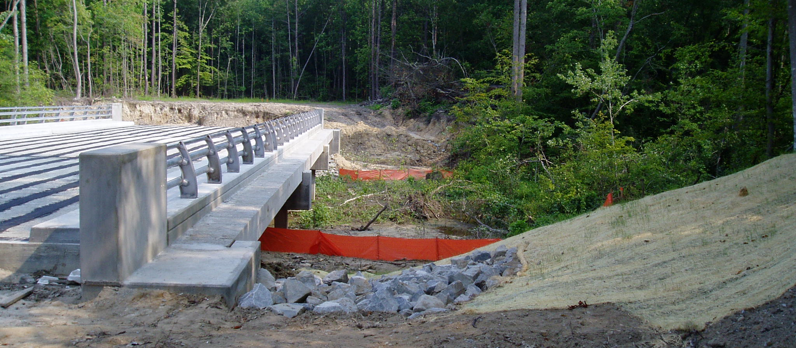
Permit Process
Wetland Assessment
Delineation
Obtain Confirmation from USACE (Jurisdictional Determination)
Joint Permit Application for wetland impacts

Slide 16
General Permits
Federal – Nationwide Permits
NWP 7 for outfalls to wetlands
NWP 13 for shoreline repair
NWP 18 for minor discharges
NWP 19 for minor dredging
NWP 29 for residential
NWP 39 for commercial
NWP 54 for living shorelines
NWP 58 / 59 for utilities
State DEQ – General Permits
WP2 for utilities
WP3 for linear transportation projects
WP4 for developments
VMRC
City Wetland Boards
Both often require public hearings

Slide 17
Individual Permits
Not preferred by applicants
Costs more
Takes more time
Greater risk to applicant due to other agencies’ & public involvement
Becoming harder to use general permits
Less inventory of land attractive for development
During revision of NWP’s USACE tightens thresholds for eligibility

Slide 18
Mitigation Required When You Permit Wetlands
Purchase credit from mitigation bank
In lieu fee when mitigation banks not available
Onsite mitigation
Requires permitting as part of the JPA
Wetlands mitigation plan
Success criteria
Monitoring up to 10 years

Slide 19
Things You Can Do in Wetlands W/O Permit 9 VAC 25-210-60
Silviculture (logging and land management within limitations)
Debris removal provided it is done in an environmentally sound manner
Agricultural activities in existing farmed wetland areas
Mowing provided the area was historically mowed
Vegetation maintenance (trimming, removal of dead / diseased / noxious vegetation)
Repair and maintenance of existing serviceable structures in wetlands (docks, bulkheads, utilities, etc)
Maintenance of existing ditches provided that the design of the ditch does not change (depth, width, etc)

Slide 20
Things in a Wetlands That Require a Permit
Soil disturbance (filling, excavating)
Includes grubbing during logging – leave the stumps, unless under silvicultural exemption
Altering the hydrology of a wetland (wetter or dryer)
Converting a wetland into a new use (agriculture or development including lawn space)
Staging of materials in wetland areas during construction
Mechanized clearing of wetlands
Crossing over or under wetland areas with piers, bridges or utilities

Slide 21
Options When Agency Takes a Hard Line
Who do you have on your team
Consultant?
Attorney?
Not smart to “do it yourself”
Keep negotiating
Acquiesce to the agency
Abandon the project
Use court to reverse the agency

Slide 22
Enforcement
Administrative
Up to $10k/day (maximum $125k)
Civil
Up to $25k/day
Injunction
Criminal
Negligent violation: up to $25k/day & up to 1 year
Knowing violation: up to $50k/day & up to 3 years
Knowing endangerment: up to $250k & up to 15 years
False statement in application or other document: up to $10k & up to 2 years
Citizen’s Environmental Lawsuit

Slide 23
Additional Resources
Blog article: The Supreme Court’s Hawkes Co. Decision May Help Save Your Project When Wetlands are Present
https://www.waterfrontpropertylaw.com/blog/posts/supreme-court-hawkes-co-decision-presence-of-wetlands/EPA Fact Sheet
Virginia Tidal Wetlands Violations in Review From an Environmental Lawyer
https://www.waterfrontpropertylaw.com/blog/posts/what-to-do-if-you-have-been-charged-with-a-tidal-wetlands-violation/
The VMRC’s Implementation of the Living Shoreline Requirement of SB776
https://www.waterfrontpropertylaw.com/blog/posts/vmrc-implementation-of-living-shoreline-requirement/

Slide 24
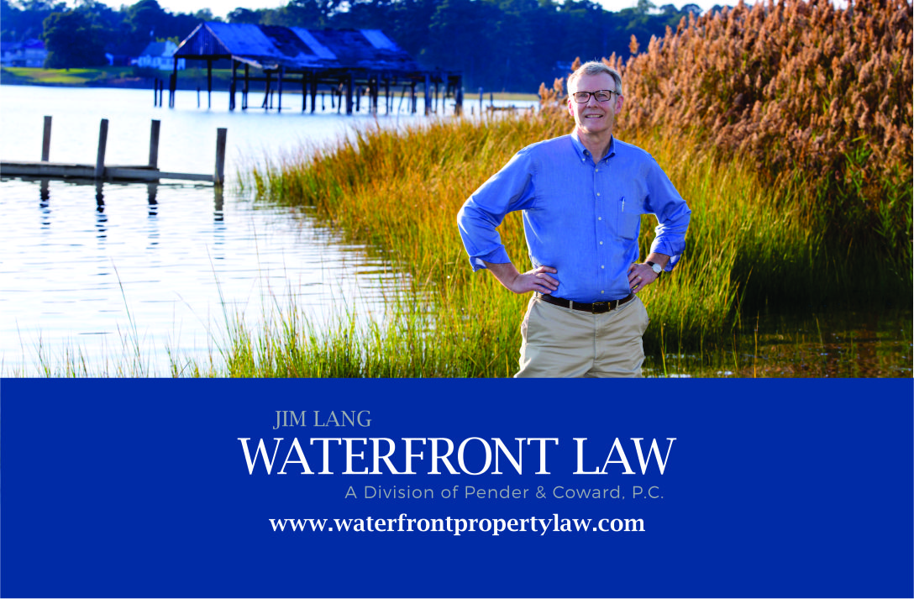
Questions?
(757) 502-7326
jlang@pendercoward.com
490-9264
Brian.owen@msaonline.com

